Slide 1
PS3 DSIVE Erosion
Sponsored by IBM & GE
Prepared by
Syed Ali
Paul Ireifej
Justin Law
Carlos Lazo
Nicholas Matthews
Shahab Rastegar
Thomas Smith
Mahmutcan Tarzi
Professor Junichi Kanai

Slide 2
Semester Objectives
Provide IBM and GE an end-to-end system
  Playstation3 running a Linux distribution
  Network connectivity for the Playstation3
  Simulation Hardware
  Transferring Images to the PPE for processing
  Implement Image Processing Algorithm
  Develop Parallel Processing Usage
  Output Log File

Slide 3
Executive Summary
Purpose of a steam turbine is to produce the maximum amount of electrical energy in the minimum amount of space
steam turbines drive about 86% of all electric generation in the world
Water droplet erosion on the end of the turbine blades occurs within approximately 2-3 years of use.

Slide 4
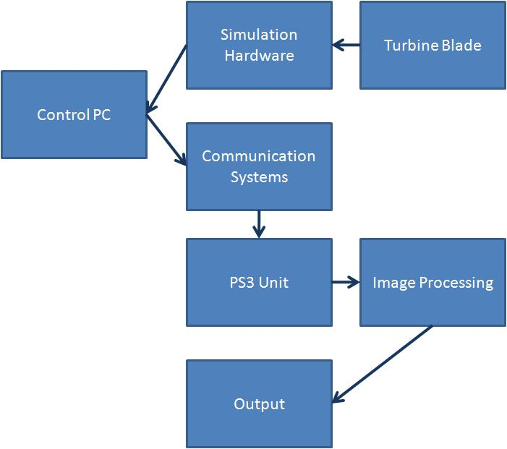
Executive Summary
Develop a sensing system to measure the rate of erosion on the steam turbine blades
Work in collaboration with the GE fall 2007 Erosion team; this group will provide images
Simulation hardware: borescope camera connected to a desktop computer

Slide 5
Executive Summary
Images from simulation hardware sent to “Control PC” which is attached to the PS3 unit by a “communication system”
Run image processing algorithm to quantify the amount of erosion on the blade by taking advantage of the PS3 Cell Broadband Processor
Output erosion numerical results to an external log

Slide 6
Current Progress
Yellow Dog Linux (YDL) 5.0.2, all necessary drivers for the PlayStation 3 and the IBM SDK are conveniently included by default
Operational: remote SSH, dynamic domain name system (DDNS)
Decision has been finalized to use MATLAB as a test bed to model algorithm implementations as a preliminary step to coding

Slide 7
Specific System Deliverables
Image orientation and analysis code in Matlab
Deployed code ported to PS3’s Cell architecture
Functional system using Parallel Processing Code for efficiency

Slide 8
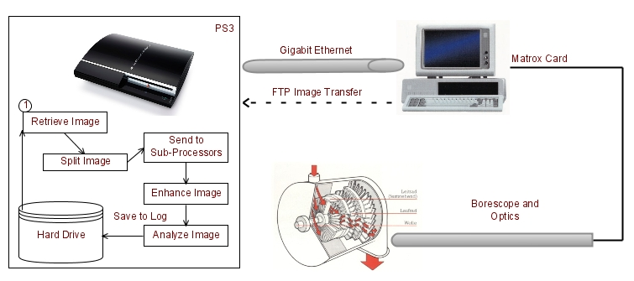
System Specification
Communication Systems
Hardware Simulation
Image Processing
Parallel Processing

Slide 9
System Concepts Analysis
Image Processing Algorithms
Output Consideration
Turbine maintenance and efficiency improvement for GE
PS3 energy efficiency and processor performance vs. PC with similar specifications

Slide 10
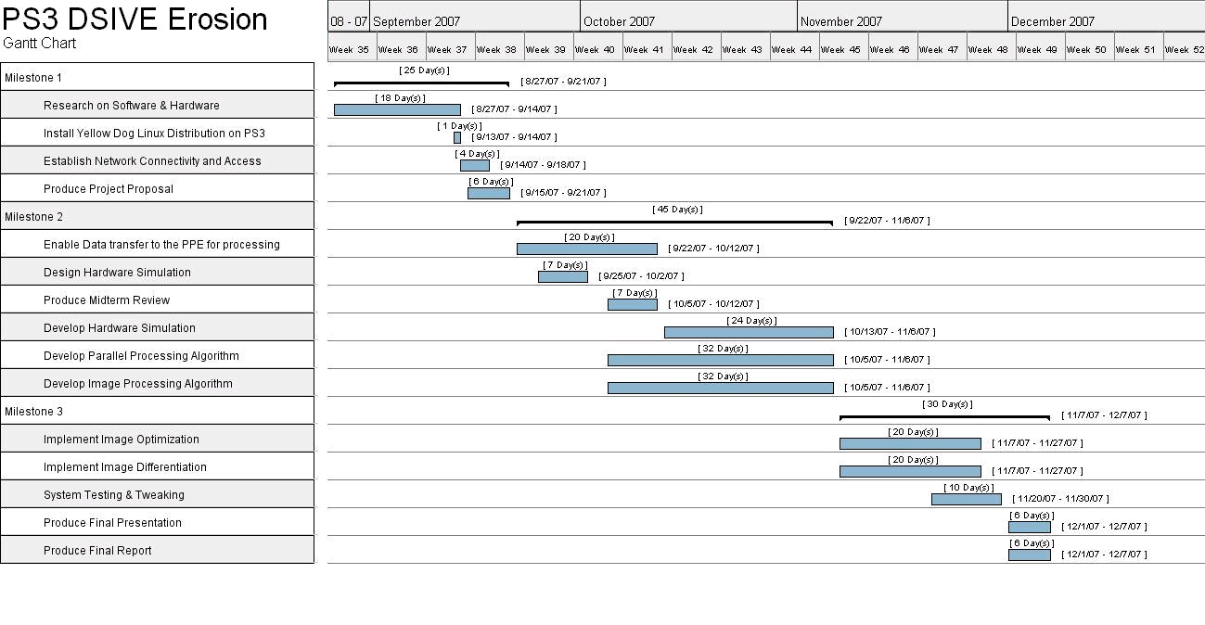
Project Plan

Slide 11
End of Semester Objectives
System ready for use by end of semester, potential stepping stone for future project development
Complete system implemented on PS3 & PC with meaningful erosion analysis
Optimized image analysis code for the PS3 Cell Broadband Engine
Adequate documentation for all software processes and completed research

Slide 12
Any questions?

